Slide 1
Frontiers of Microeconomics
© 2015 Cengage Learning. All Rights Reserved. May not be copied, scanned, or duplicated, in whole or in part, except for use as permitted in a license distributed with a certain product or service or otherwise on a password-protected website for classroom use.

Slide 2
Asymmetric Information
Information asymmetry
  “I know something you don’t know”
  A difference in access to relevant knowledge
  Hidden action: Moral hazard
    The principal-agent problem
  Hidden characteristic: Adverse selection
    The lemons problem
© 2015 Cengage Learning. All Rights Reserved. May not be copied, scanned, or duplicated, in whole or in part, except for use as permitted in a license distributed with a certain product or service or otherwise on a password-protected website for classroom use.

Slide 3
Hidden Actions
Moral hazard
  Person who is imperfectly monitored
  Tendency to engage in dishonest or otherwise undesirable behavior
Agent
  Person who is performing an act for another person (the principal)
© 2015 Cengage Learning. All Rights Reserved. May not be copied, scanned, or duplicated, in whole or in part, except for use as permitted in a license distributed with a certain product or service or otherwise on a password-protected website for classroom use.

Slide 4
Hidden Actions
Principal
  Person for whom another person (the agent) is performing some act
Employment relationship
  Moral hazard
  Employer is the principal
  Worker is the agent
© 2015 Cengage Learning. All Rights Reserved. May not be copied, scanned, or duplicated, in whole or in part, except for use as permitted in a license distributed with a certain product or service or otherwise on a password-protected website for classroom use.

Slide 5
Hidden actions
Moral-hazard problem (employer-employee)
  The temptation of imperfectly monitored workers to shirk their responsibilities
Responses to moral hazard problem
  Better monitoring
  High wages (efficiency-wage theories)
  Delayed payment
© 2015 Cengage Learning. All Rights Reserved. May not be copied, scanned, or duplicated, in whole or in part, except for use as permitted in a license distributed with a certain product or service or otherwise on a password-protected website for classroom use.

Slide 6
Hidden actions
Moral-hazard problems
  A homeowner with fire insurance buys too few fire extinguishers
    Homeowner bears the cost of the extinguisher
    Insurance company receives much of the benefit
  Family lives near a river with a high risk of flooding
    Family enjoys the scenic views
    Government bears the cost of disaster relief
© 2015 Cengage Learning. All Rights Reserved. May not be copied, scanned, or duplicated, in whole or in part, except for use as permitted in a license distributed with a certain product or service or otherwise on a password-protected website for classroom use.

Slide 7
Hidden actions
Regulations aimed at addressing the problem
  Insurance company - require homeowners to buy fire extinguishers
  Government - prohibit building homes on land with high risk of flooding
  The insurance company and the government
    Don’t have perfect information
    The problem of moral hazard persists
© 2015 Cengage Learning. All Rights Reserved. May not be copied, scanned, or duplicated, in whole or in part, except for use as permitted in a license distributed with a certain product or service or otherwise on a password-protected website for classroom use.

Slide 8
Hidden Characteristics
Adverse selection
  Mix of unobserved attributes
  Tendency to become undesirable from the standpoint of an uninformed party
Market for used cars
  Sellers know the defects of cars better than prospective buyers
  Problem: owners of good cars keep them rather than sell them at the low price
© 2015 Cengage Learning. All Rights Reserved. May not be copied, scanned, or duplicated, in whole or in part, except for use as permitted in a license distributed with a certain product or service or otherwise on a password-protected website for classroom use.

Slide 9
Hidden Characteristics
Labor market
  Workers – know their abilities better than firms
  Problem: wages – above equilibrium
    Unemployment
Markets for insurance
  People buying insurance – know more than insurance company
  Problem: buyers with low risk - uninsured
© 2015 Cengage Learning. All Rights Reserved. May not be copied, scanned, or duplicated, in whole or in part, except for use as permitted in a license distributed with a certain product or service or otherwise on a password-protected website for classroom use.

Slide 10
Signaling
Signaling
  Action taken by an informed party to reveal private information to an uninformed party
  Firms – advertising
  Students – college degree
Effective signaling
  Costly
  More beneficial - higher-quality product
© 2015 Cengage Learning. All Rights Reserved. May not be copied, scanned, or duplicated, in whole or in part, except for use as permitted in a license distributed with a certain product or service or otherwise on a password-protected website for classroom use.

Slide 11

Gifts as signals
Gift giving
  Reflects asymmetric information and signaling
Choosing a good gift
  Signal of love
  Costly - it takes time
  Cost depends on private information
Giving cash as gift
  Signal: May offend
“Now we’ll see how much he loves me.”
© 2015 Cengage Learning. All Rights Reserved. May not be copied, scanned, or duplicated, in whole or in part, except for use as permitted in a license distributed with a certain product or service or otherwise on a password-protected website for classroom use.

Slide 12
Screening
Screening
  Action taken by an uninformed party
  To induce an informed party to reveal information
Seller of car insurance
  Low premium policy (with deductible) to safe drivers
  High premium policy (without a deductible) to risky drivers
© 2015 Cengage Learning. All Rights Reserved. May not be copied, scanned, or duplicated, in whole or in part, except for use as permitted in a license distributed with a certain product or service or otherwise on a password-protected website for classroom use.

Slide 13
Public Policy
Asymmetric information
  Market may fail to put resources to their best use
  May call for government action
  Complications:
    Private market - deal with information asymmetries (signaling and screening)
    Government - rarely has more information than the private parties
    Government - imperfect institution
© 2015 Cengage Learning. All Rights Reserved. May not be copied, scanned, or duplicated, in whole or in part, except for use as permitted in a license distributed with a certain product or service or otherwise on a password-protected website for classroom use.

Slide 14
Political Economy
Political economy
  Study of government using the analytic methods of economics
  Public choice
The Condorcet voting paradox
  Failure of majority rule to produce transitive preferences for society
© 2015 Cengage Learning. All Rights Reserved. May not be copied, scanned, or duplicated, in whole or in part, except for use as permitted in a license distributed with a certain product or service or otherwise on a password-protected website for classroom use.

Slide 15
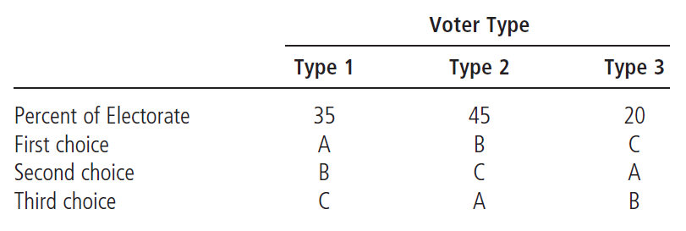
Table 1
The Condorcet Paradox
If voters have these preferences over outcomes A, B, and C, then in pairwise majority voting, A beats B, B beats C, and C beats A.
© 2015 Cengage Learning. All Rights Reserved. May not be copied, scanned, or duplicated, in whole or in part, except for use as permitted in a license distributed with a certain product or service or otherwise on a password-protected website for classroom use.

Slide 16
Arrow’s Impossibility Theorem
Properties for voting system:
  Unanimity
    If everyone prefers A to B, then A should beat B
  Independence of irrelevant alternatives
    Ranking between any two outcomes A & B should not depend on whether outcome C is also available
© 2015 Cengage Learning. All Rights Reserved. May not be copied, scanned, or duplicated, in whole or in part, except for use as permitted in a license distributed with a certain product or service or otherwise on a password-protected website for classroom use.

Slide 17
Arrow’s Impossibility Theorem
Properties for voting system:
  Transitivity
    If A beats B, and B beats C, then A should beat C
  No dictators
    There is no person who always gets his way regardless of everyone else’s preferences
© 2015 Cengage Learning. All Rights Reserved. May not be copied, scanned, or duplicated, in whole or in part, except for use as permitted in a license distributed with a certain product or service or otherwise on a password-protected website for classroom use.

Slide 18
Arrow’s Impossibility Theorem
Arrow’s impossibility theorem
  Mathematical result
  Under certain assumed conditions
  There is no scheme for aggregating individual preferences
    Into a valid set of social preferences
© 2015 Cengage Learning. All Rights Reserved. May not be copied, scanned, or duplicated, in whole or in part, except for use as permitted in a license distributed with a certain product or service or otherwise on a password-protected website for classroom use.

Slide 19
The Median Voter Is King
Median voter theorem
  Mathematical result
  If voters are choosing a point along a line
  And each voter wants the point closest to his most preferred point
  Then majority rule will pick the most preferred point of the median voter
© 2015 Cengage Learning. All Rights Reserved. May not be copied, scanned, or duplicated, in whole or in part, except for use as permitted in a license distributed with a certain product or service or otherwise on a password-protected website for classroom use.

Slide 20
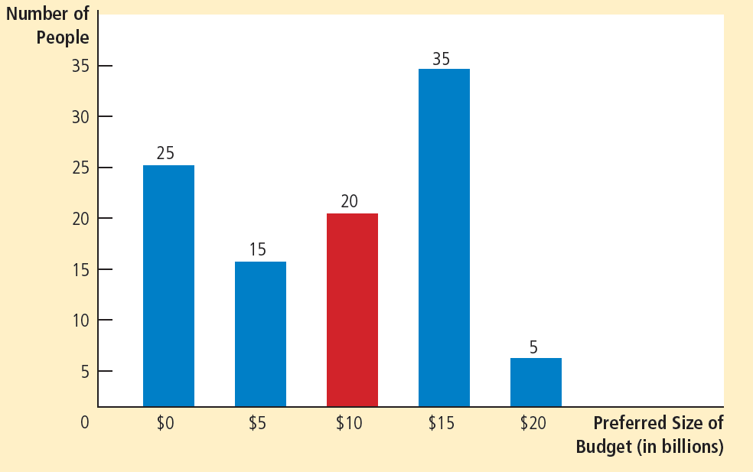
Figure 1
The Median Voter Theorem: An Example
This bar chart shows how 100 voters’ most preferred budgets are distributed over five options, ranging from zero to $20 billion. If society makes its choice by majority rule, the median voter (who here prefers $10 billion) determines the outcome.
© 2015 Cengage Learning. All Rights Reserved. May not be copied, scanned, or duplicated, in whole or in part, except for use as permitted in a license distributed with a certain product or service or otherwise on a password-protected website for classroom use.

Slide 21
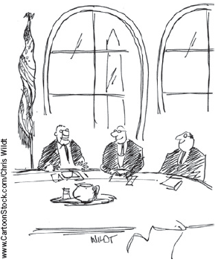
The Median Voter Is King
Implications of the median voter theorem
  Parties in a two-party system
    Move toward the median voter
  Minority views are not given much weight
Majority rule
  Looks only to the person in the exact middle of the distribution
“Isn’t that the real genius of democracy? . . .
The VOTERS are ultimately to blame.”
© 2015 Cengage Learning. All Rights Reserved. May not be copied, scanned, or duplicated, in whole or in part, except for use as permitted in a license distributed with a certain product or service or otherwise on a password-protected website for classroom use.

Slide 22
Politicians Are People Too
Politicians
  Have objectives
  Nice to assume (not realistic)
    Looking out for the well-being of society as a whole
    Aiming for an optimal combination of efficiency and equality.
  Self-interest – powerful motive
    Desire for reelection
    Greed
© 2015 Cengage Learning. All Rights Reserved. May not be copied, scanned, or duplicated, in whole or in part, except for use as permitted in a license distributed with a certain product or service or otherwise on a password-protected website for classroom use.

Slide 23
Behavioral Economics
Behavioral economics
  Subfield of economics
  Integrates the insights of psychology
Imperfections of human reasoning
  Forgetful, impulsive, confused, emotional, and shortsighted
© 2015 Cengage Learning. All Rights Reserved. May not be copied, scanned, or duplicated, in whole or in part, except for use as permitted in a license distributed with a certain product or service or otherwise on a password-protected website for classroom use.

Slide 24
People Aren’t Always Rational
People aren’t always rational
  Not rational maximizers
    Always choosing the best course of action
  Satisficers
    Make decisions that are merely good enough
  Near rational
  Bounded rationality
© 2015 Cengage Learning. All Rights Reserved. May not be copied, scanned, or duplicated, in whole or in part, except for use as permitted in a license distributed with a certain product or service or otherwise on a password-protected website for classroom use.

Slide 25
People Aren’t Always Rational
Systematic mistakes that people make
  People are overconfident
  People give too much weight to a small number of vivid observations
  People are reluctant to change their minds
© 2015 Cengage Learning. All Rights Reserved. May not be copied, scanned, or duplicated, in whole or in part, except for use as permitted in a license distributed with a certain product or service or otherwise on a password-protected website for classroom use.

Slide 26
People Aren’t Always Rational
Economics - built on the rationality assumption
  Yields reasonably accurate models of behavior
  Economists are themselves not rational maximizers
© 2015 Cengage Learning. All Rights Reserved. May not be copied, scanned, or duplicated, in whole or in part, except for use as permitted in a license distributed with a certain product or service or otherwise on a password-protected website for classroom use.

Slide 27

Left-Digit Bias
Buyers are excessively sensitive to a price’s left-most digit
  An irrational focus on the left-most digit is called left-digit bias
Why not add a penny to this price?
© 2015 Cengage Learning. All Rights Reserved. May not be copied, scanned, or duplicated, in whole or in part, except for use as permitted in a license distributed with a certain product or service or otherwise on a password-protected website for classroom use.

Slide 28
Left-Digit Bias
Choice of buying two different pens
  When the pens were priced at $2.00 and $3.99
    44% bought the higher-priced pen
  When the prices were $1.99 and $4.00
    18% bought the more expensive one
© 2015 Cengage Learning. All Rights Reserved. May not be copied, scanned, or duplicated, in whole or in part, except for use as permitted in a license distributed with a certain product or service or otherwise on a password-protected website for classroom use.

Slide 29
Left-Digit Bias
Millions of used cars sold at auction
  Odometer reading increased from 78,000 to 79,000
    The price of the car fell by about $10
  Odometer reading increased from 79,000 to 80,000
    The price fell by $210
  Prices of used cars jumped down at every 10,000 mile mark
    Left-most digit on the odometer changed
© 2015 Cengage Learning. All Rights Reserved. May not be copied, scanned, or duplicated, in whole or in part, except for use as permitted in a license distributed with a certain product or service or otherwise on a password-protected website for classroom use.

Slide 30
People Care About Fairness
Ultimatum game: split $100 between two players
  Only one player decides the shares
    99-1: acceptable and rational
    60-40: fair
Perceived fairness of what a firm pays its workers
  Especially profitable year
    Workers may expect to be paid a fair share of the prize
© 2015 Cengage Learning. All Rights Reserved. May not be copied, scanned, or duplicated, in whole or in part, except for use as permitted in a license distributed with a certain product or service or otherwise on a password-protected website for classroom use.

Slide 31
People are Inconsistent over Time
People are inconsistent over time
  People make plans for themselves
    But then they fail to follow through
  People should try to find ways to commit their future selves to following through on their plans
© 2015 Cengage Learning. All Rights Reserved. May not be copied, scanned, or duplicated, in whole or in part, except for use as permitted in a license distributed with a certain product or service or otherwise on a password-protected website for classroom use.

